Slide 1
CS440/520 Artificial Intelligence
Computer Science Department
Lecture 4:
Review of Informed Search -
Adversarial Search
11 September 2014
Instructor: Kostas Bekris

Slide 2
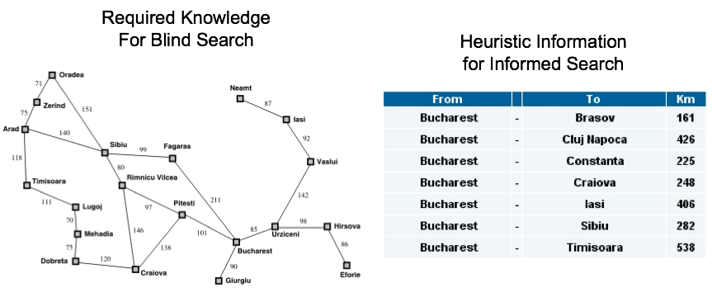
Informed Search
So far the techniques made use only of information that could be stored on a graph, i.e., the successor function
282
538
Often, however, we have available problem-specific knowledge that can help.
When additional information is used... we talk about “Informed Search”.
How can we take advantage of such additional information?

Slide 3
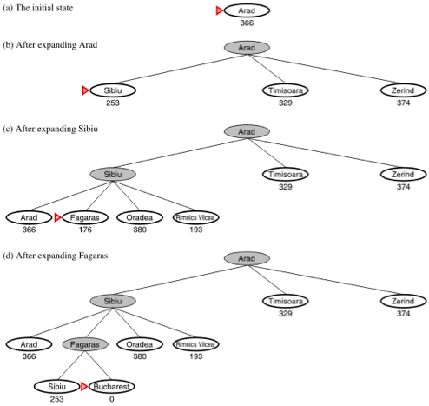
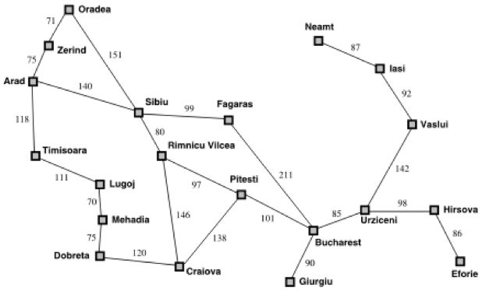
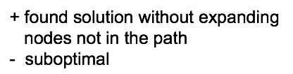
Greedy Best-First Search
Best-first Search: Optimize an evaluation function f: X →R
Heuristic: h(n)
estimated cost of the optimum path from n
Greedy Approach
f(n) = h(n)

Slide 4

Greedy Best-First Search
Select the node from the fringe that optimizes an evaluation function f(n)
Implementation:
Priority queue (e.g., binary heap)
Heuristic function:
h(n): estimated cost of the cheapest path from node n to a goal node
computable for all states
h(n) = 0, iff n is a goal state
Greedy BFS:
Expand the node closer to the goal according to the heuristic: f(n) = h(n)

Slide 5
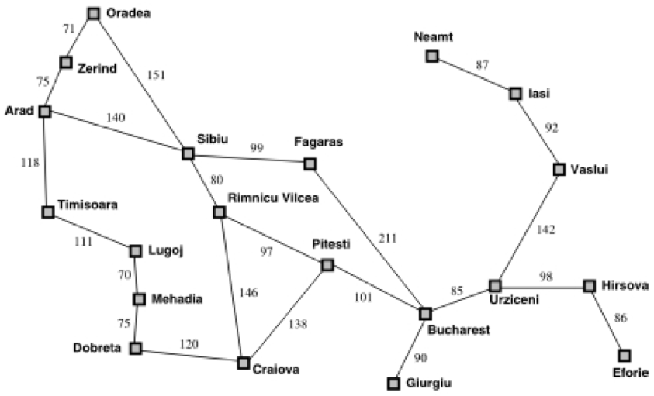
From Iasi to Fagaras

Slide 6
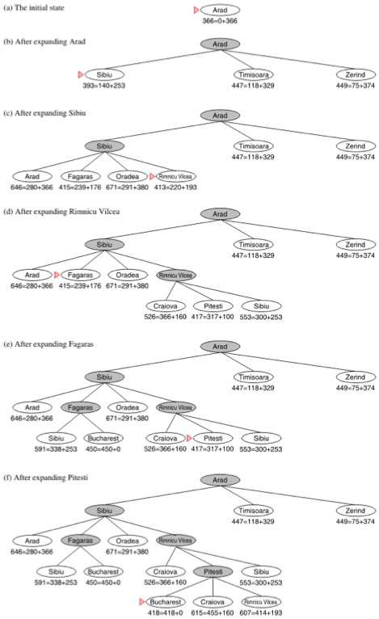
A*
Objective
Minimize the total estimated solution cost: f(n) = g(n) + h(n)
g(n): cost from start to the goal
Case 1: TREE-SEARCH
(allow repeated states)
If h(n) admissible
then A* is optimal
Admissible = Optimistic
Never overestimate the cost to goal
e.g., straight-line distance between cities on a map, Manhattan distance in grids, etc.

Slide 7
A*
Case 2: GRAPH-SEARCH
(avoid repeated states)
Admissibility is not sufficient.
2 solutions to retain optimality:
once you found a repeated state, discard the more expensive path (extra book-keeping, expensive)
make sure the first path followed to a repeated state is optimal
If h(n) is consistent then A* is optimal
Admissible = Monotonic
Satisfies the triangular inequality

Slide 8
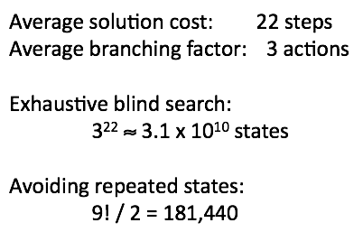
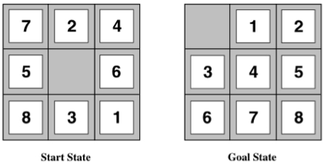
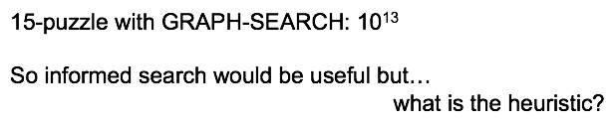

Design of Heuristics
Neither overestimates the true solution cost (=26 steps)

Slide 9
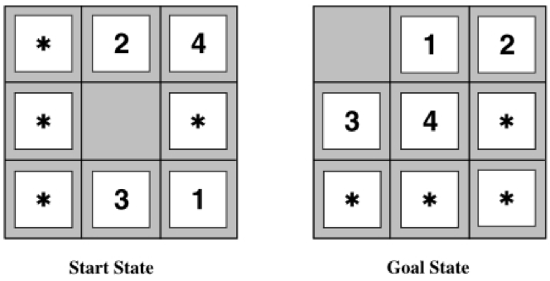

Sub-problem Heuristics

Slide 10
Adversarial Search
}
Checkers
Othello
Chess
Backgammon
Go: We are still better, machines are amateurs!
They are hard search problems…
e.g., chess:
Average branching factor: 35 choices per step
Average game length: 50 moves per game
Search tree: 35¹⁰⁰ or 10¹⁵⁴ (distinct: “only” about 10⁴⁰)
Forget about the optimal decision… infeasible!
machines have surpassed human champions

Slide 11
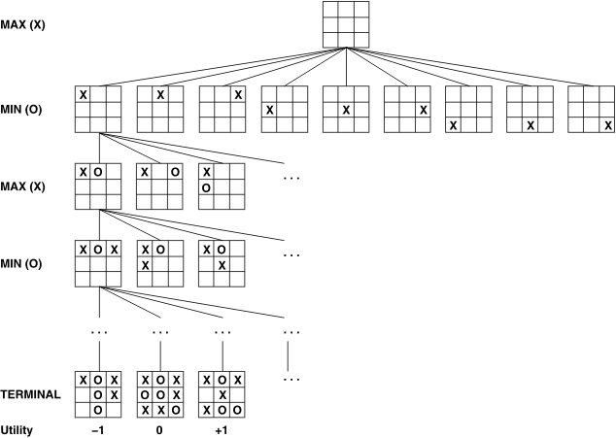
Tic-Tac-Toe

Slide 12
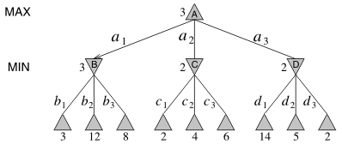
Minimax Algorithm

Slide 13
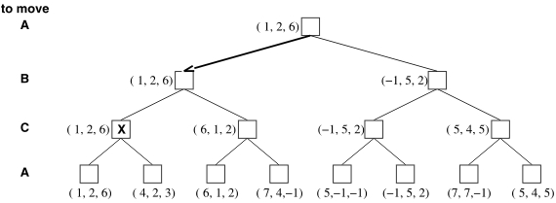
More than 2 players

Slide 14
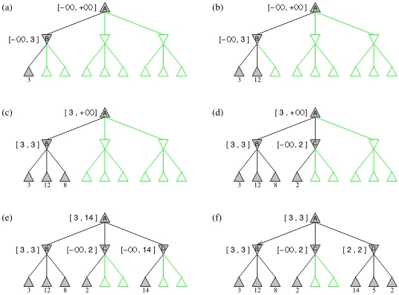
α-β (alpha-beta) pruning

Slide 15
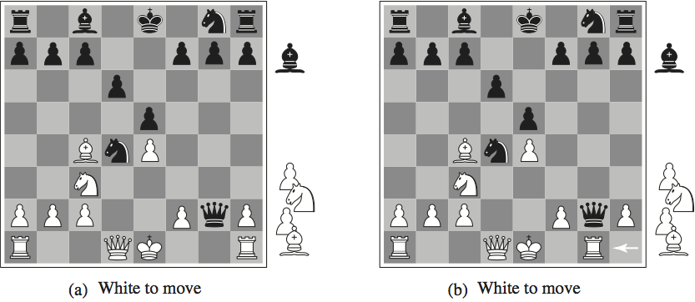
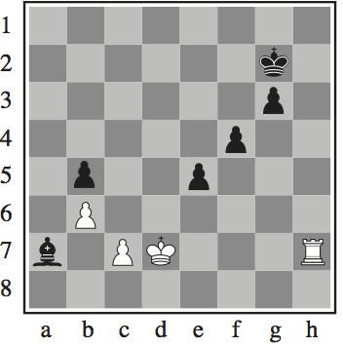
Chess

Slide 16
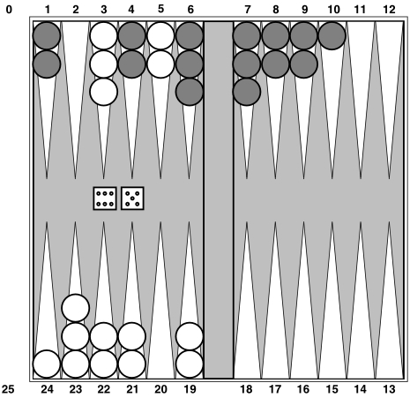
Backgammon

Slide 17
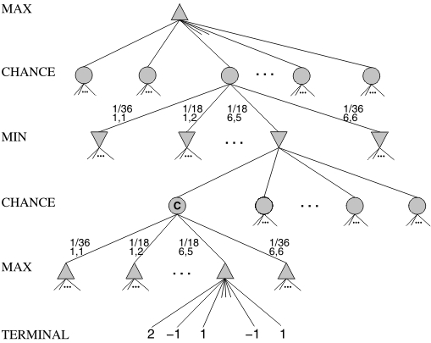
Chance in Games

Slide 18
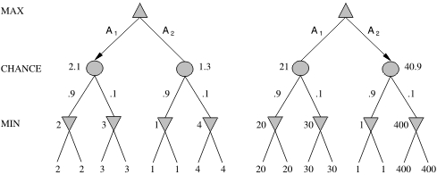
Scaling Issues

